Slide 1
INTRODUCTION TO Animation

Slide 2

What is animation?
'To animate' literally means to give life to.
Animating is moving something that cannot move on it's own.

Slide 3
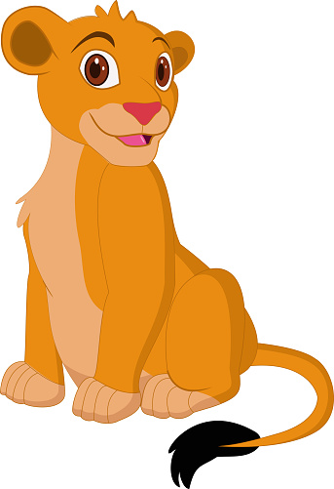
Types of Animation
• Traditional Animation
• 2D Animation
• 3D Animation
• Motion Graphics
• Stop Motion

Slide 4
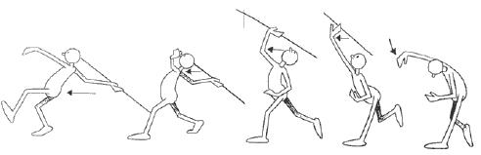
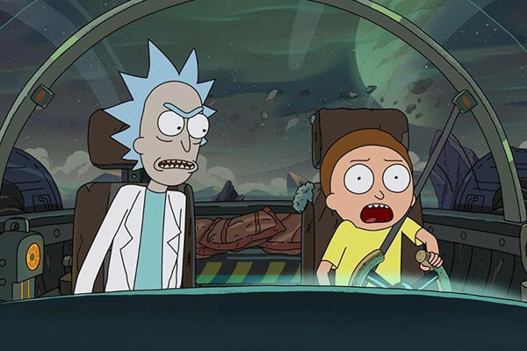
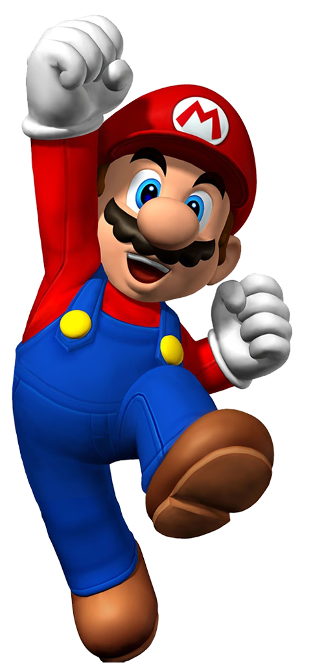
1. Traditional Animation
This type of animation requires the animator to draw every single frame by hand to create an animated scene.
2. 2D Animation
2D animation refers to vector-based animations similar to the ones used in Flash.
3. 3D Animation
The process of 3D animation is very different from the traditional style but they both require the artist to share the same principles of movement and composition in animation.

Slide 5

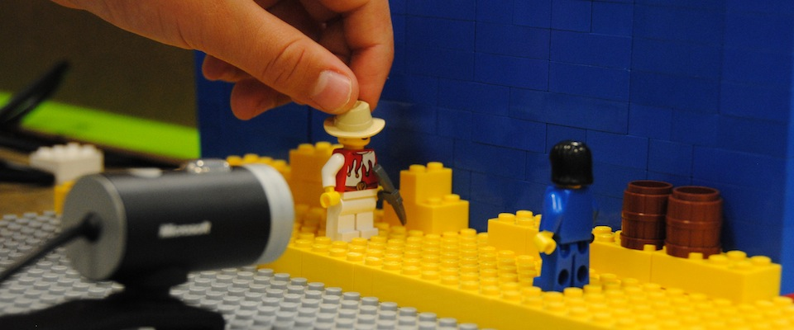
4. Motion Graphics
This art form focuses on the ability to move graphic elements, shapes, and text. This process is commonly used for things like television promotions, explainer videos, and animated logos.
5. Stop Motion
Stop motion animation is very similar to traditional animation because it combines a series of still images that are slightly different to show movement. The largest difference is that stop motion uses photography and captures real objects.

Slide 6
Principle of Animation

Slide 7
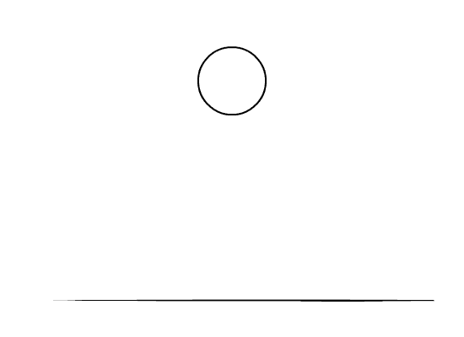
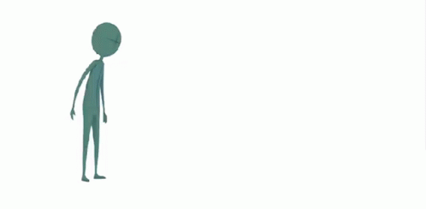
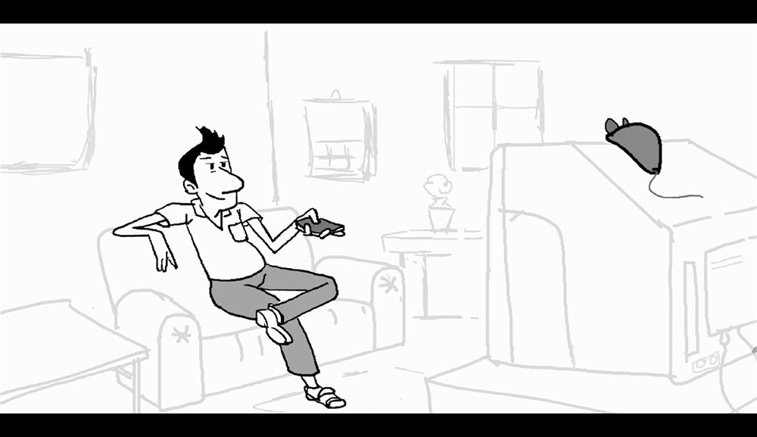
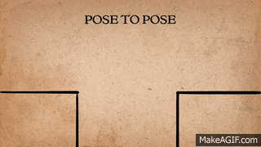
01. Squash and stretch
it gives your animated characters and objects the illusion of gravity, weight, mass and flexibility.
02. Anticipation
Anticipation helps to prepare the viewer for what's about to happen.
03. Staging
Keep the focus on what's important within the scene, and keep the motion of everything else of non-importance to a minimum.
04. Straight ahead action and pose to pose
Straight ahead action involves drawing frame-by-frame from start to finish.
With the pose to pose technique, you draw the beginning frame, the end frame, and a few key frames in-between

Slide 8
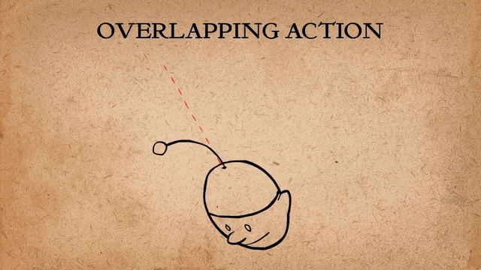
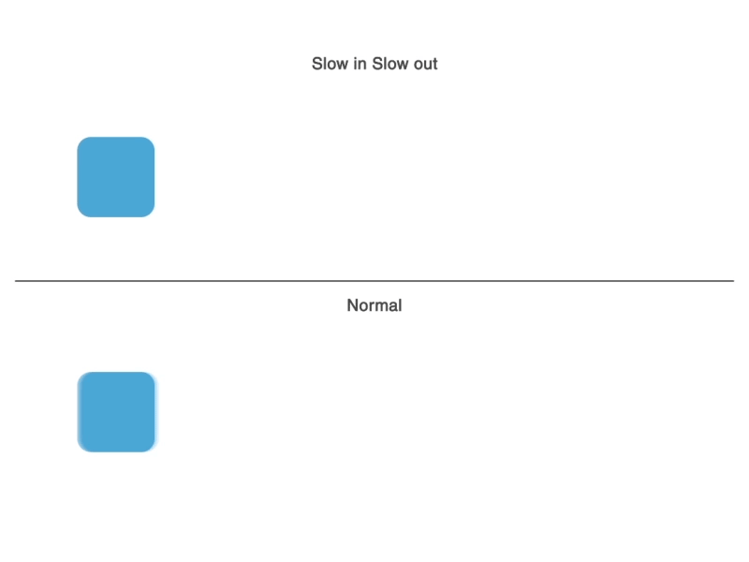
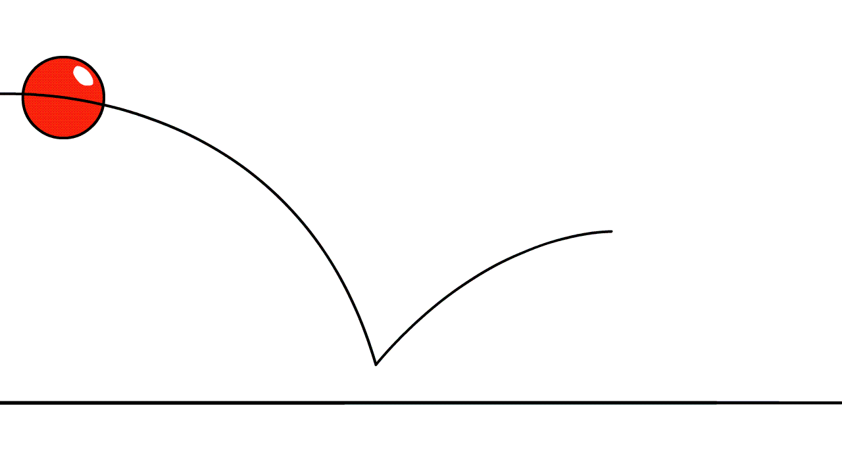
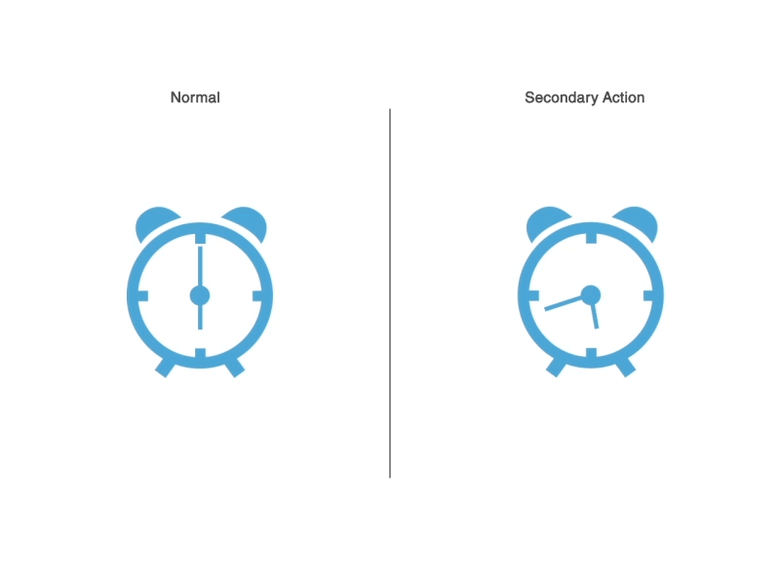
05. Follow through and overlapping action
If your character is running across the scene, their arms and legs may be moving at a different rate from their head. This is overlapping action.
Likewise, when they stop running, their hair will likely continue to move for a few frames before coming to rest – this is follow through.
06. Slow in and slow out
The best way to understand slow in and slow out is to think about how a car starts up and stops. It will start moving slowly, before gaining momentum and speeding up.
07. Arc
Most objects follow an arc or a path when they're moving, and your animations should reflect that arc.
08. Secondary action
Secondary actions are used to support or emphasise the main action going on within a scene.

Slide 9
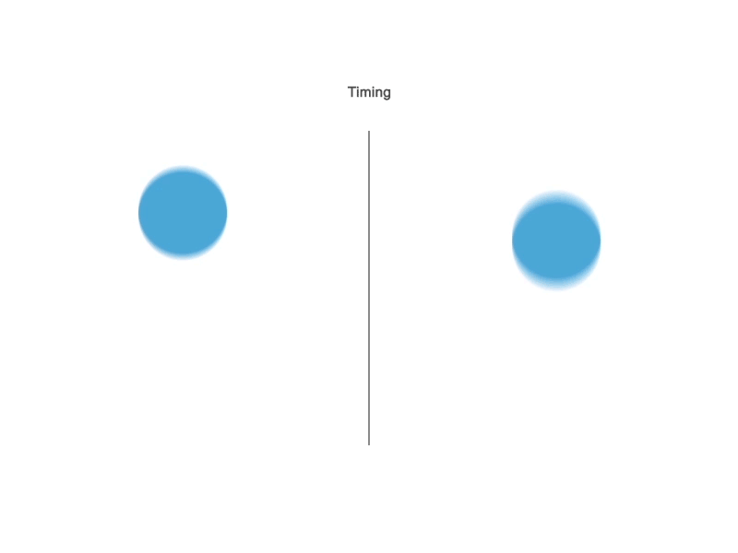
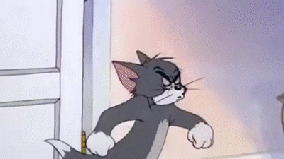
09. Timing
Using the correct timing allows you to control the mood and the reaction of your characters and objects.
10. Exaggeration
Too much realism can ruin an animation, making it appear static and boring

Slide 10
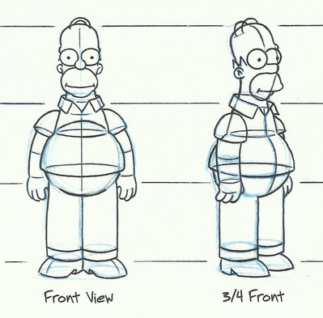
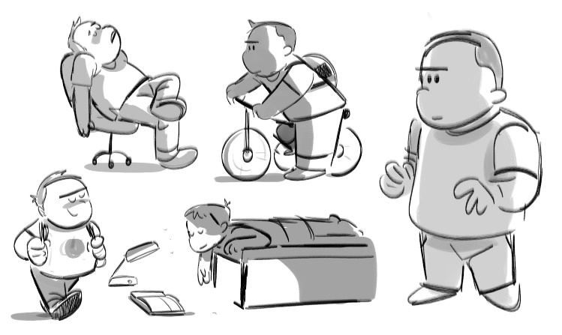
11. Solid drawing
This includes knowing how to draw in three-dimensional space and understanding form and anatomy, weight and volume, and lights and shadows.
12. Appeal
Your characters, objects, and the world in which they live need to appeal to the viewer.

Slide 11
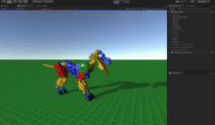
Types of Animation Systems
Scripting Systems
Scripting Systems were the earliest type of motion control systems. The animator writes a script in the animation language.
Procedural Animation
Procedures are used that define movement over time. These might be procedures that use the laws of physics (Physically - based modeling) or animator generated methods.

Slide 12
Representational Animation
This technique allows an object to change its shape during the animation. The first is the animation of
Stochastic Animation
This uses stochastic processes to control groups of objects, such as in particle systems. Examples are fireworks, fire, water falls, etc.
Behavioural Animation
Objects or "actors" are given rules about how they react to their environment. Examples are schools of fish or flocks of birds where each individual behaves according to a set of rules defined by the animator.

Slide 13


